Slide 1

PRESENTATION
Unveiling Hotel Aggregator Analysis Insights
With Microsoft Power Bi
DATA ANALYST GEORGIA GITAU

Slide 2

01.
Problem Statement
Table of Content
02.
Exploratory Data Analysis in PowerBi
03.
Data Vsisualization
04.
Findings
Conclusion & Recommendations
05.

Slide 3

Problem Statement
Here's a brief description of the Hotel Aggregator problem statement.
Challenge: The hotel aggregator platform needs to understand what makes listings successful to improve overall quality and competitiveness.
Data: We have a rich dataset containing details about listings, hosts, reviews, and availability.
Goal: Analyze this data using Power BI to uncover trends and factors influencing listing performance.
01

Slide 4

Dataset Description
Here's an understanding of the data.
The listings are a total of 23,185 with 75 unique columns/attributes.
A variety of the datapoints captured are listings, hosts, reviews, availability.
1. id: Unique identifier for each listing.
2. listing_url: URL of the listing on the hotel aggregator platform.
3. scrape_id: Identifier for the data scraping event.
4. last_scraped: Date of the last data scrape.
5. source: Source of the listing information.
6. name: Name of the listing.
7. description: Description of the listing.
8. neighborhood_overview: Overview of the neighborhood where the listing is located.
9. picture_url: URL of the listing's picture.
10. host_id: Unique identifier for the host.
11. ... (and many more columns capturing details about hosts, location, property type, room details,
amenities, pricing, availability, reviews, and other relevant information)
01

Slide 5




Key Areas of Analysis
Geographical Insights: Where are the most popular locations and host concentrations?
Pricing and Availability: How do prices vary based on property type, room type, and capacity? What are the peak availability periods?
Host Performance: Does Superhost status, response time, or verification methods affect listing performance?
Review Scores and Guest Satisfaction: How do review scores impact performance? Can we identify areas for improvement?
Property Type and Room Analysis: What are the most popular property and room types? Are there any changing trends?
02

Slide 6


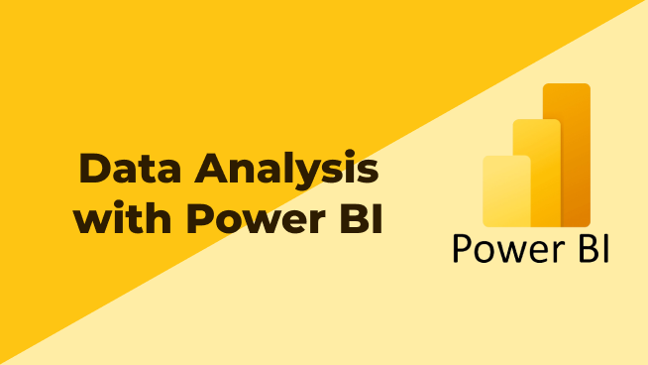

Slide 7
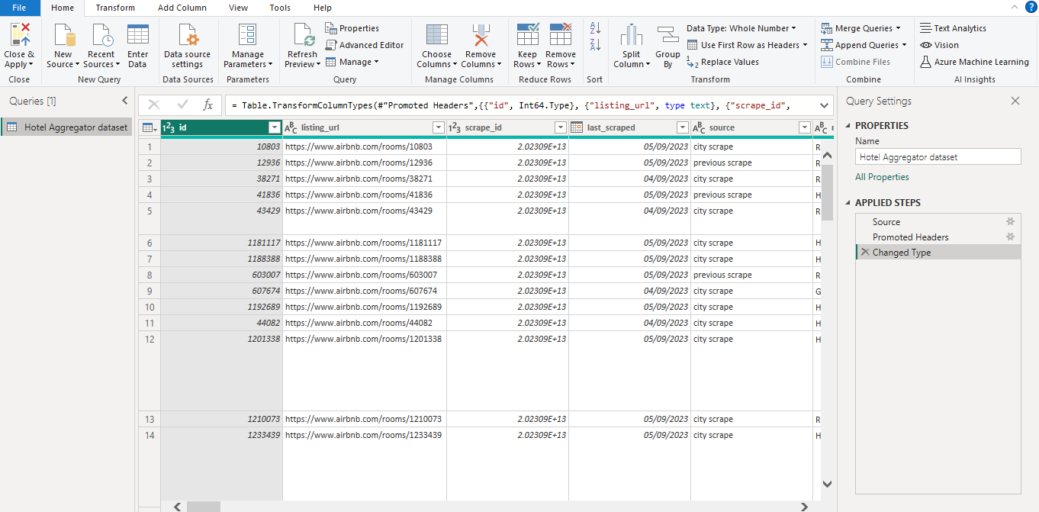
1. Load & Transform the Dataset through Power Query.
03

Slide 8
2. Data Cleaning and Transformation.
Power Query: I utilized Power Query Editor, a powerful tool within Power BI for data cleaning and transformation. I addressed potential issues like inconsistencies, formatting errors & data quality problems.
Column Removal: I removed irrelevant columns to streamline the dataset and focus on the most important information for the analysis.
Missing Value Handling: I made informed decisions about handling missing values. I kept relevant missing values, imputing values based on certain criteria & excluding rows with too many missing values.
Case Sensitivity: I ensured data consistency by converting specific characters (f to F and t to T).
04

Slide 9
3. Data Analysis and Measures Creation.
DAX Functions and Measures: I created DAX functions & measures. These are custom calculations within Power BI used to derive new insights from the data.
Calculated Metrics: I created measures to calculate total listings, total hosts, and available listings. These metrics provided a quick overview of the dataset's scope.
Host Listing Distribution: I discovered that some hosts have multiple listings on the platform. This finding was relevant for further analysis of host performance.
05

Slide 10




4. Data Analysis & Visualization in PowerBi
1. Geographical Insights
2.Pricing and Availability Analysis
3. Host Performance
4.Property Type and Room Analysis
06

Slide 11
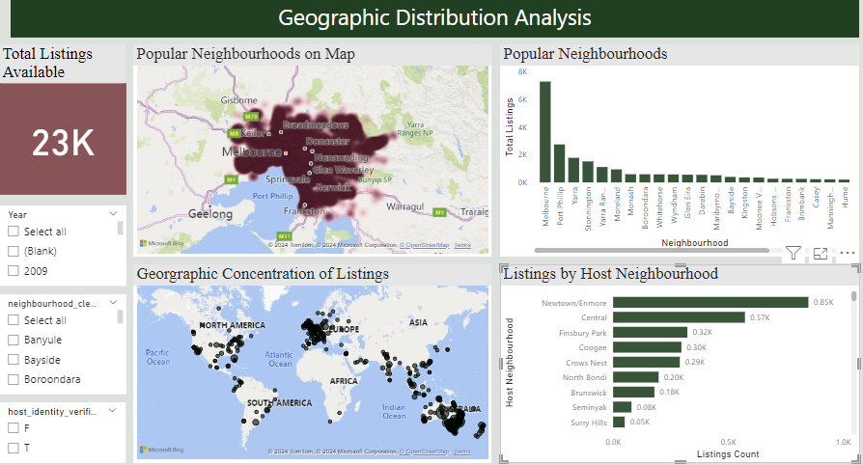
07

Slide 12
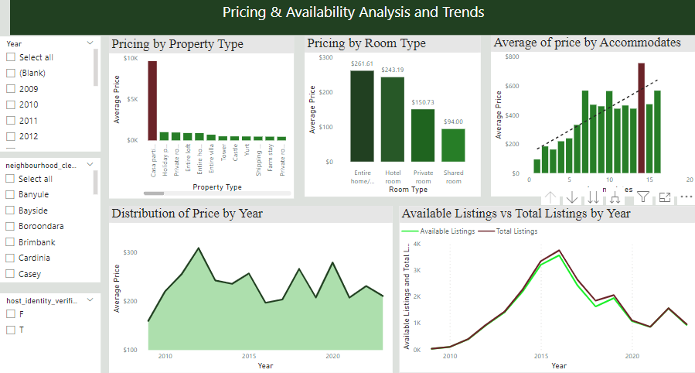
08

Slide 13
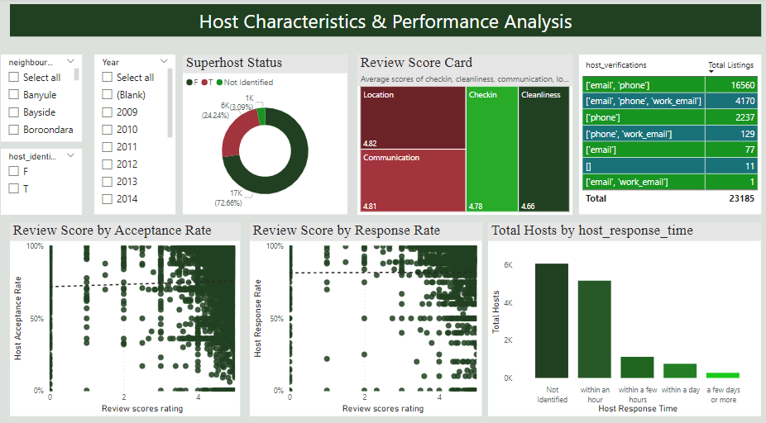
09

Slide 14
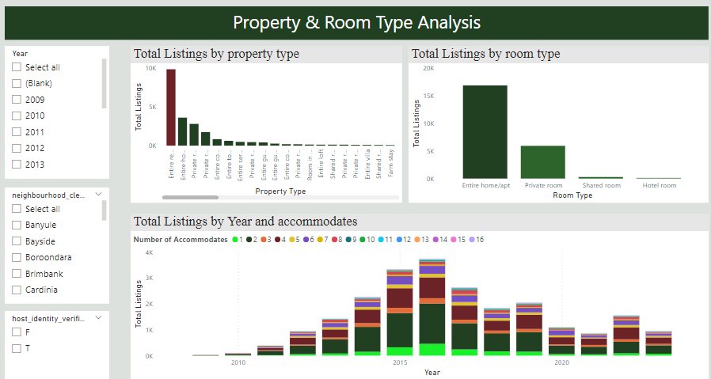
10

Slide 15

5. Findings
1. Geographical Insights:
Popular Neighborhoods: Melbourne Australia 31% listings followed by Port Phillip at 11%.
Host Concentration: High concentrations of hosts are recorded in Newton/Enmore Neighborhood.
2. Pricing and Availability Analysis:
Pricing Trends: Highest prices are recorded for Casa Particular property Avg Price $9652.50
Room type best sellers: Entire home/apt $261.61.
Availability Patterns: The highest availability pattern was recorded in 2016.
3. Host Performance:
Superhost Impact: A total of 72.6% of votes are False on Superhost influence on Listings Performance.
Response Time and Verification: These features positively affected the results and performance with highs of 5 start rating.
4. Review Scores and Guest Satisfaction:
Review Score Impact: The higher the response & acceptance rate, the higher the review score to upto 5 star.
Areas for Improvement: Cleanliness had the lower rating at 4.66.
5. Property Type and Room Analysis:
Property Distribution: The most prevalent property type is an Entire Rental Unit, 42.5% of listings. Followed by Entire homes that are 15% of the 23,185 listings.
Room Type Trends: Identified popular room types are Entire home/apt followed by Private room.
The most popular listings accomodate 2.
11

Slide 16


6. Recommendations
Targeted Listings: Based on popular neighborhoods and property/room type trends, hosts can optimize their listings to cater to specific guest preferences in high-demand areas.
Pricing Strategies: Pricing strategies should consider factors like property type, room capacity, and peak seasons.
Host Support: The source platform should offer resources or incentives to encourage faster response times, increased host verification methods all of which can positively impact listing performance.
Guest Feedback Integration: Integrate guest feedback from reviews into listing improvement suggestions for hosts. This can address areas like cleanliness or amenities.
Data Completeness. To ensure efficiency and integrity, the scraped site should ensure completeness in data.
12

Slide 17

Conclusion
This data analysis using Power BI provided valuable insights into factors influencing hotel aggregator listing performance.
By understanding geographical trends, pricing dynamics, host characteristics, and guest satisfaction factors, the platform can empower hosts to optimize their listings and attract more bookings.
Utilizing these insights, the platform can further enhance its overall listing quality and competitiveness in the market.
13

Slide 18
Thank You
gathonigeorgia@gmail.com
+254-710-772-342
Nairobi, Kenya

